Slide 1
Detect Alzheimer from Speech
Intern: Zhiyuan Chen (Jennifer)
Mentor: Vijay Ravi

Slide 2
Introduction to the problem
Database
Baseline Experimental Details
Baseline results
Previous work
What we’re currently doing

Slide 3
ADReSSo Challenge
Alzheimer's Dementia Recognition through Spontaneous Speech (only)
2020 ADReSS Challenge:
• speech recording + manual script
acoustic feature + linguistic feature
2021 ADReSSo Challenge:
• speech recording only
focuses on the acoustic characteristic of speech
Binary Classification
diagnosis
3 tasks
Regression over MMSE score
prognosis

Slide 4
2021 database
Speech recordings of 2 distinct datasets:
- (prognosis) AD patients performing semantic fluency task for baseline visit
- (diagnosis) picture descriptions by AD patients and control group
Speech sample: 237 participants
166 training + 71 testing (7/3 split)
Training data: .wav files + segmentation timestamps
Train |  | Test
ad | cn | 71
87 | 79

Slide 5
Diagnosis Baseline
Features
Acoustic: apply sliding window with 100ms to obtain frames => eGeMAPS features => ADR method
Linguistic: Google Cloud-based Speech Recogniser => convert transcripts into CHAT format => MOR function => EVAL and FREQ commands
5 Methods
Method | Decision Tree | KNN | Linear Discriminant Analysis (LDA) | Random Forest | SVM
Parameter | Leaf size: {1 to 20} | K: {1 to 20} |  | 50 trees Leaf size: {1 to 20} | Linear kernel Box constraints: {0.1 to 1.0}

Slide 6
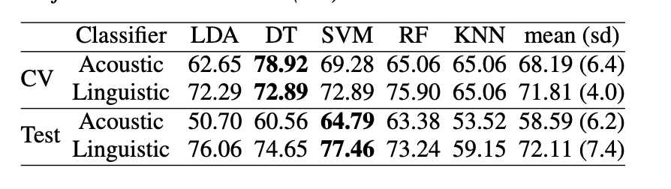
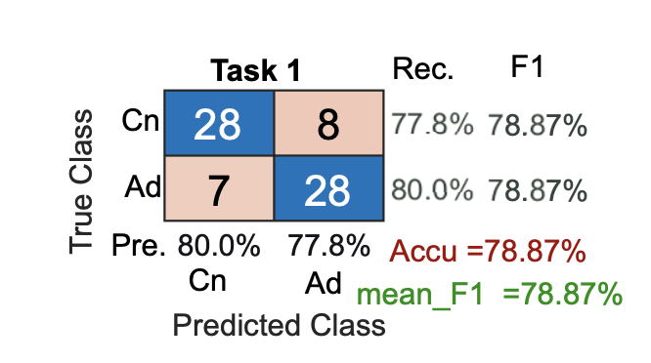
Baseline Results
Best performing classifier
Cross-validation: DT (78.92% acoustic, 72.89% linguistic)
Test set: SVM (77.46% linguistic)
Late fusion of the acoustic and linguistic models improves the accuracy on the test set
=> Baseline accuracy of 78.87%

Slide 7
Previous Work
2020 best performance paper
• 1st: 89.6% accuracy, focuses solely on linguistic feature.
Utilizes domain knowledge, process the transcript based on pause and the use of “uh”, then feed into BERT
• 2nd: 85.42% accuracy, acoustic + linguistic
Different BERT alternatives for every word of every transcript

Slide 8
2021 challenge
Paper1: outperforms the baseline model by 2.82%
• proposed a new method
(combination of engineered features + audio representations)
• pipeline
- 3 approaches for feature extraction
- 4 models: LR, SVM, NN, DT (default value for all model parameters)
• Feature extraction approaches
- approach1: conventional acoustic features
Verbal: fundamental frequency, jitter, shimmer
Non-verbal: MFCC
- approach2: pre-trained acoustic embeddings (deep neural models)
wav2vec 2.0 (self-supervised audio representation model)
- approach3: best method
combination of state-of-the-art self-supervised techniques + domain knowledge

Slide 9
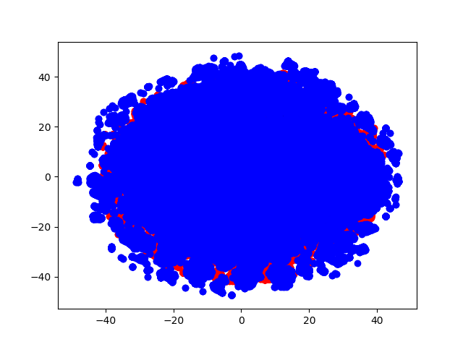
What we’re doing
Current steps:
1. Segment the audio files, then extract MFCC features
2. t-SNE visualization for MFCC
3. SVM model on MFCC feature
- provide metrics for 3 different trials on training set
- predict on frame level, then use majority voting to have the results of segment level and speaker level

Slide 10
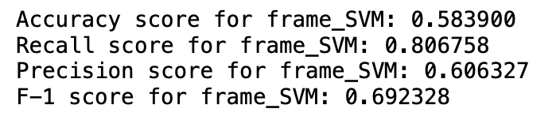
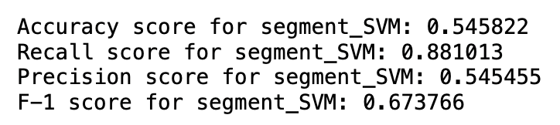
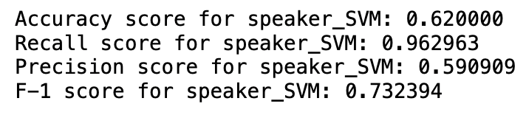
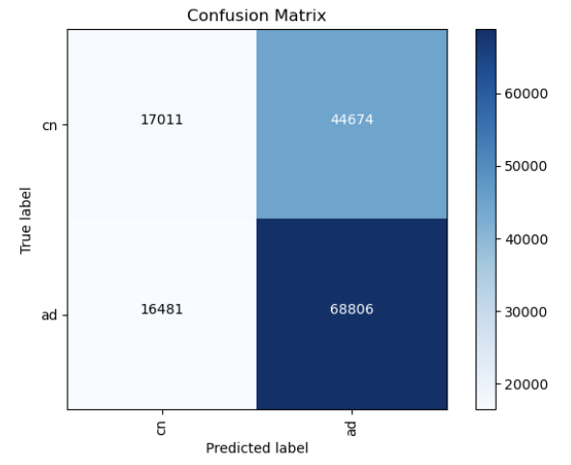
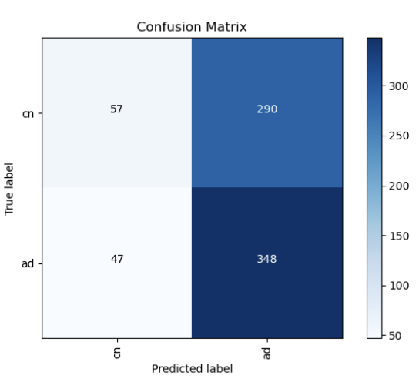
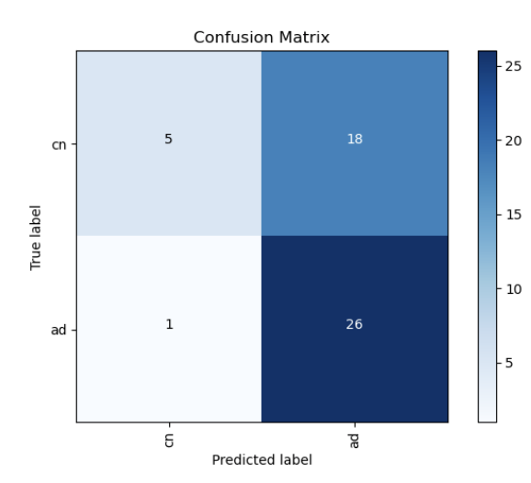
Trial 1 result
Frame level Segment level Speaker level
Next steps:
- produce SVM probability logits, average across 3 trials
- do the same for eGeMAPS, ComParE16, VQUAL, entropy

Slide 11
Thank you!

